Slide 1

Data Visualization in Python

Slide 2
Data Visualization
Data visualization is a field in data analysis that deals with visual representation of data. It graphically plots data and is an effective way to communicate inferences from data.
visual summary of our data.
With pictures, maps and graphs, the human mind has an easier time processing and understanding any given data.
significant role in the representation of both small and large data sets

Slide 3
Data Visualization in Python
Python offers several plotting libraries, namely Matplotlib, Seaborn and many other such data visualization packages with different features for creating informative, customized, and appealing plots to present data in the most simple and effective way.
Python libraries for data visualization
  Matplotlib
  Seaborn
inbuilt modules for plotting different graph
While Matplotlib is used to embed graphs into applications, Seaborn is primarily used for statistical graphs.

Slide 4
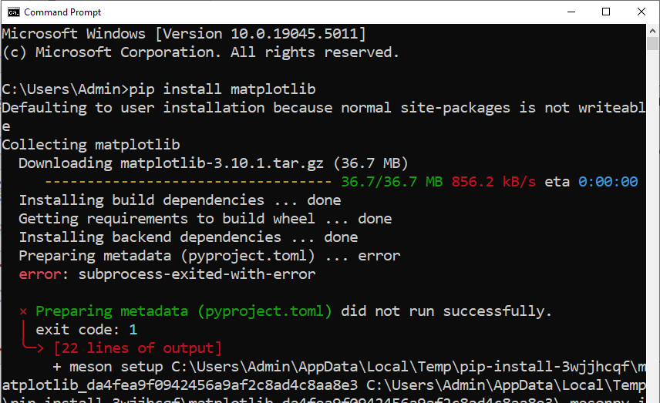
Using Matplotlib module
To import matplotlib module in the python program we need to follow the steps.
  Install matplotlib through the command prompt using pip install mtplotlib

Slide 5
Matplotlib and Seaborn
Matplotlib and Seaborn are python libraries that are used for data visualization. They have inbuilt modules for plotting different graphs.
While Matplotlib is used to embed graphs into applications, Seaborn is primarily used for statistical graphs.

Slide 6
Matplotlib vs Seaborn
Matplotlib | Seaborn
It is used for basic graph plotting like line charts, bar graphs, etc. | It is mainly used for statistics visualization and can perform complex visualizations with fewer commands.
It mainly works with datasets and arrays. | It works with entire datasets.
Matplotlib acts productively with data arrays and frames. It regards the aces and figures as objects. | Seaborn is considerably more organized and functional than Matplotlib and treats the entire dataset as a solitary unit.

Slide 7
A Line Chart
A Line chart is a graph that represents information as a series of data points connected by a straight line. In line charts, each data point or marker is plotted and connected with a line or curve.

Slide 8
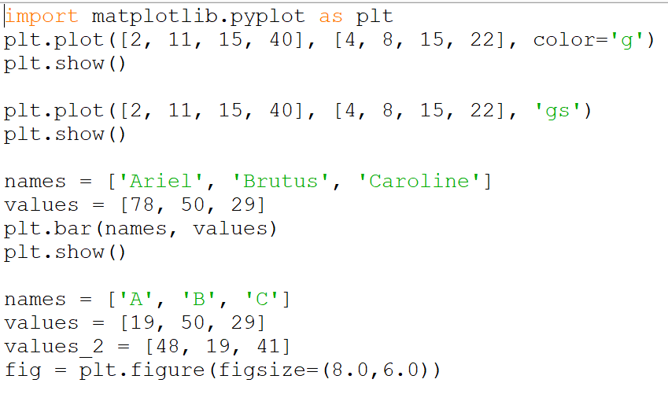
A Line Plot

Slide 9
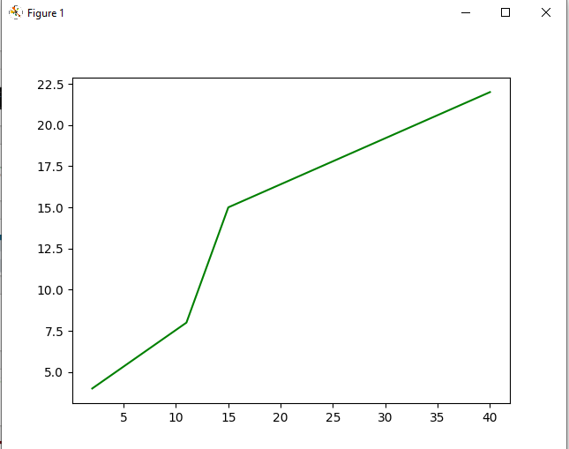

Slide 10
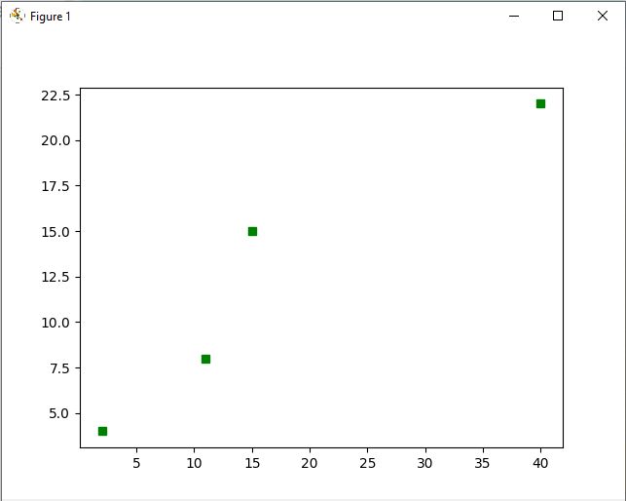

Slide 11
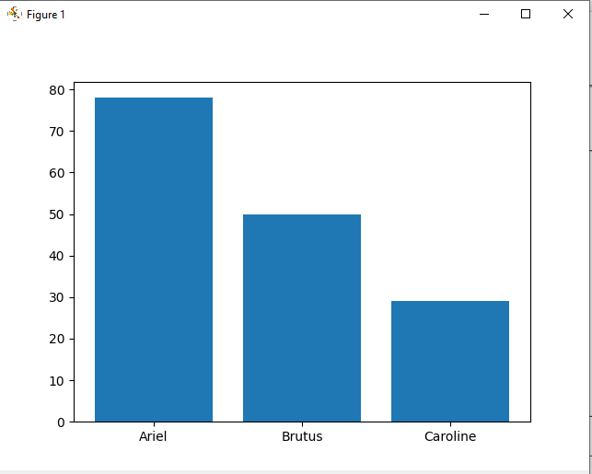

Slide 12
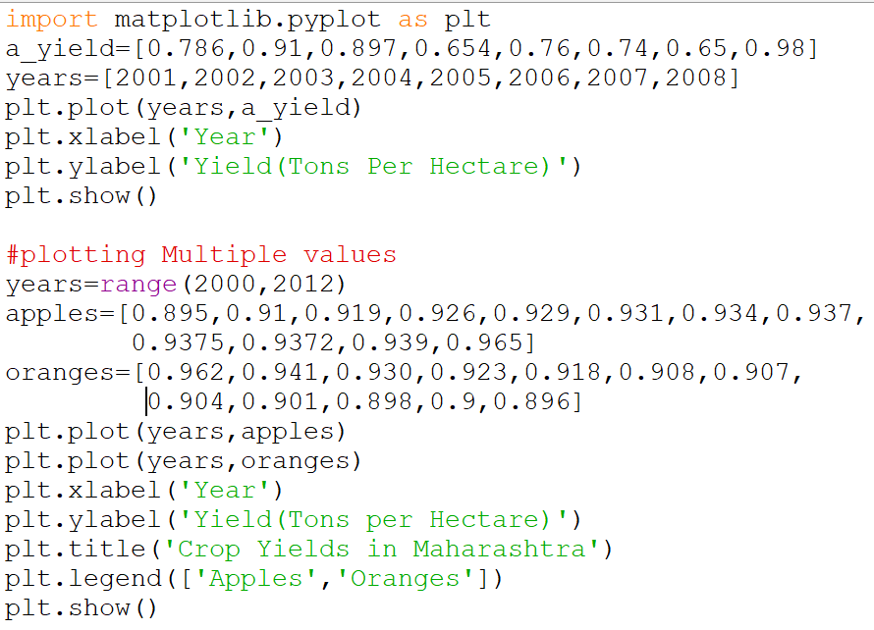

Slide 13
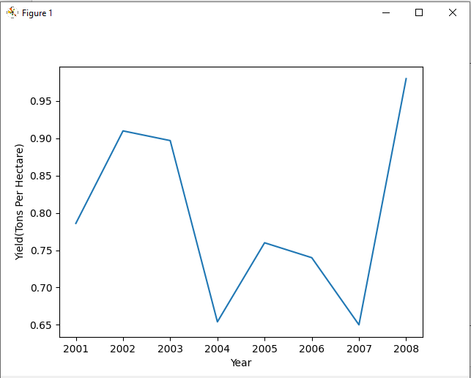
Output

Slide 14
Bar Graphs
A bar graph plots data with the help of bars, which represent value on the y-axis and category on the x-axis. Bar graphs use bars with varying heights to show the data which belongs to a specific category.

Slide 15
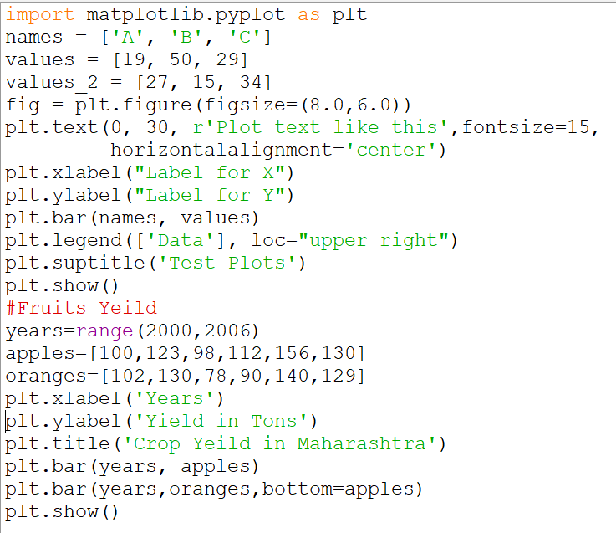
Bar Graph

Slide 16
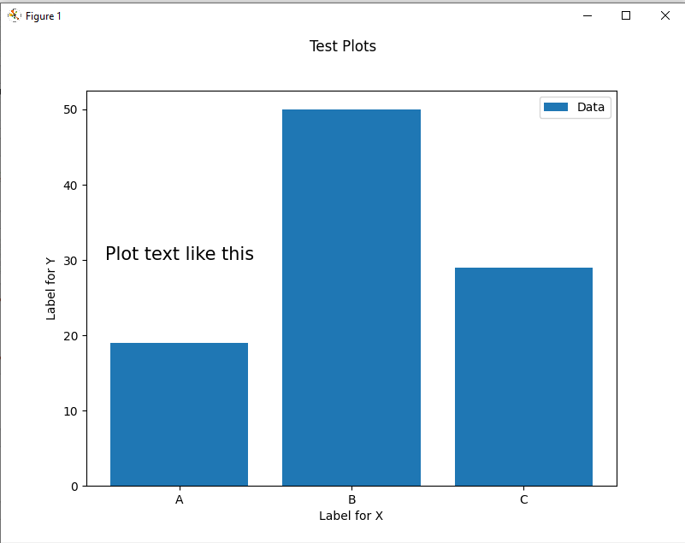
Output

Slide 17
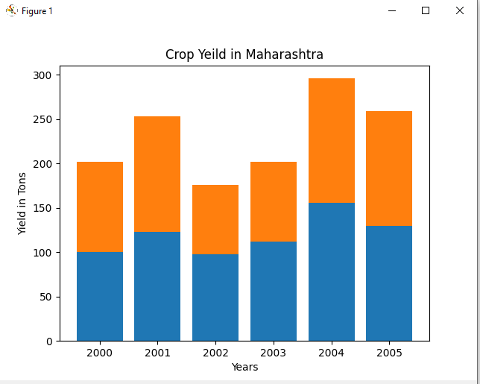

Slide 18
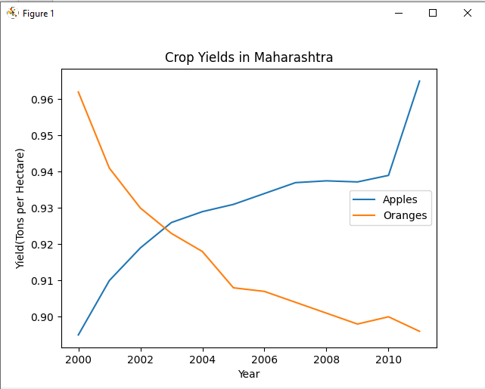

Slide 19
Histogram
A Histogram is a bar representation of data that varies over a range.
It plots the height of the data belonging to a range along the y-axis and the range along the x-axis.
Histograms are used to plot data over a range of values. They use a bar representation to show the data belonging to each range.

Slide 20
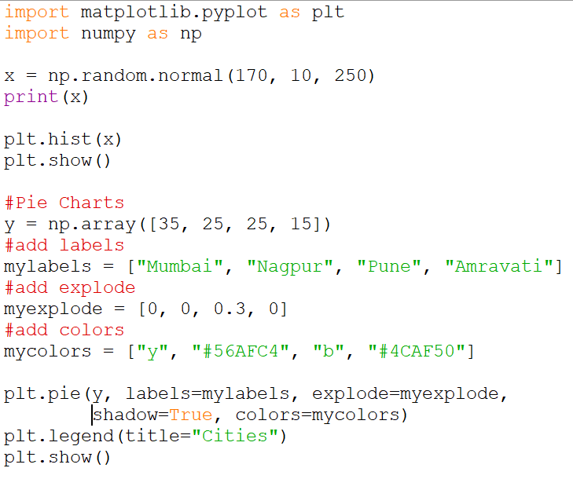

Slide 21
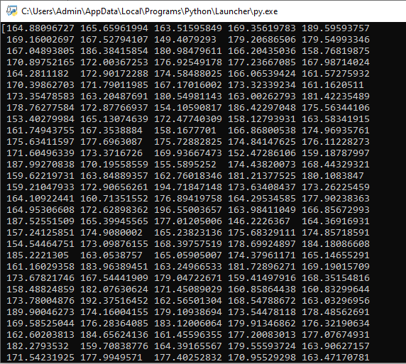
Output

Slide 22
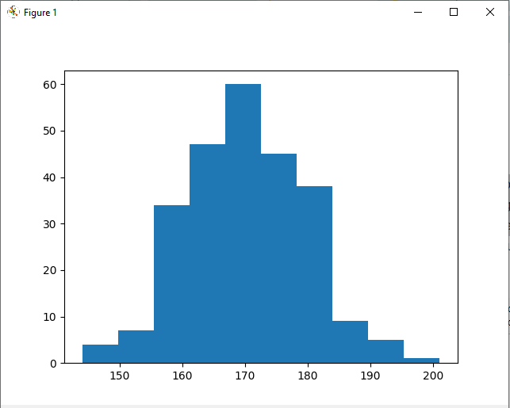
Output

Slide 23
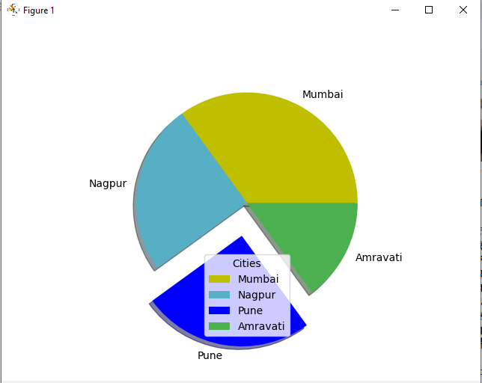
Pie Chart

Slide 24
The End

